Slide 1
Domestic Violence History, definitions, and Counseling models
Presented by
Dr. Barry Lord LMFT 32239

Slide 2
Early treatment of Women
Early hunter gatherers, division of labor
who were the hunters? gatherers?
Defined roles, women highly esteemed, valued for life giving role, “power of creation”,
Agricultural, egalitarian societies
Extended families, lineage traced through the mother

Slide 3
Societal Changes
Mosaic & Babylonian Laws:
Private property ownership
slavery
Men’s control over women
Aristotle, “The male is by nature superior, and the female inferior”

Slide 4
Middle Ages Practices
“The Common Scold”
“The Rule of Thumb”
Chastity Belt
Foot Binding - China

Slide 5
American Colonies
Married women had no political or legal rights
Acceptance of English Common Law
“Wife Beating” condoned

Slide 6
Early Feminists
1792 Mary Wollstonecraft
1820-30 women gave voice temperance, anti-slavery, education.
1848 first “women’s rights” meeting
1878 England “Matrimonial Causes Act”
1890 “Women’s Suffrage Assoc.”

Slide 7
1900 - 1970
World War One -
“Keep the Home fires Burning”
19th Amendment to Constitution
World War Two - “Rosie the Riveter”
1950s migration & move to suburbs
NOW formed 1966

Slide 8
1970s
Battered Women's Movement begins underground, and providing shelters
Multifaceted nature of Family Violence
Entrenched belief that the woman was the cause of the problem
Lens of responding agencies affected response confusion – Important!!

Slide 9
1980s
Is DV a civil problem….
or a criminal problem?
1984 U.S. Surgeon General “Task Force on Family Violence”
Still confusion in responding agencies
Recognition that comprehensive view necessary for societal change

Slide 10
1990s
Duluth Model –
1994 –
O.J. Trial
Violence Against Women Act
Passed Congress, became law
Most significant change for DV

Slide 11
2000 – 2018
Shelter & victim services expanded
Law enforcement & Prosecutor training
2005 VAWA reauthorized
Coordinated response solidified
Offender treatment options…….
This is where YOU come in!

Slide 12
Domestic Violence What is it?
DV is any form of abuse, violence and or coercion by a partner or previous partner
It serves to establish and maintain power and control over another person.
It has the potential to cause harm to the physical and or emotional well being of that person.

Slide 13
Types of Abuse
Physical abuse
Includes: hitting, slapping, pushing, kicking… or threatening to harm you in any way and the use of a weapon of object to
threaten or hurt you.
Includes object damage, throwing or smashing things, breaking furniture or personal items and hurting or killing pets.
Hurting someone physically or threatening to hurt them is a criminal offence.

Slide 14
Sexual abuse:
Involves pressuring or forcing you to do sexual things that you don’t want to do, even if you have had consensual sex before with this person.
If under the influence of drugs or alcohol, or are asleep and you are unaware of the sexual act it is considered sexual abuse . It is still not consensual.

Slide 15
Verbal abuse
Discussion with audience:
What is the difference between “arguing” and verbal abuse?

Slide 16
Verbal Abuse is:
Puts downs in front of others
Uses put downs, calls names or yells at her.
It could be about what you are wearing or acting, telling you you’re useless or wrong.
Brings up painful issues, “hits below the belt”
Uses language to intimidate

Slide 17
Emotional abuse includes:
Making threats, ignoring, using looks or actions or speaking in ways in which are frightening or threatening and/or making you think your crazy.
Threatens to hurt you or himself if you break up with him.

Slide 18
Social abuse includes:
Making threats, ignoring, using looks or actions or speaking in ways which are frightening or threatening and/or making you think your crazy.
If your partner threatens to hurt you or himself if you break up with him.
Controlling what you do, whom you talk to, where you go and question you on every detail of what you did without him.
Uses jealousy or anger to intimidate you or to control your behavior.

Slide 19
Financial abuse involves:
Keeping you financially dependent
Trying to keep you from getting a job
Controlling the money
Refusing to involve you in financial decision making
Making you ask for money and give an account for how you spent it.

Slide 20
Spiritual abuse occurs:
Your partner stops you from practicing the religion of your choice, going to church or reading religious material.
It could be when you are forced to practice the religion of his choice.
Religious teachings are often used to justify behavior.
Using constant abuse against you, your own “personal spirit” will be undermined.
You could loose your sense of worth and self esteem will be lowered as a result.

Slide 21
Animal abuse
This is used to demonstrate power and control over the family.
It helps keep victims isolated, forces the family to keep violence secret, and enforces submission.
Unwanted Communication:
What might that include?

Slide 22
Unwanted communication includes:
Telephone calls, constant text messaging on mobile, phones, letters and messages through friends.
It’s used to harass, intimidate and threaten.

Slide 23
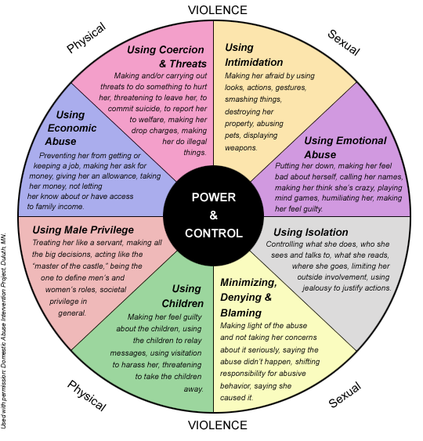

Slide 24
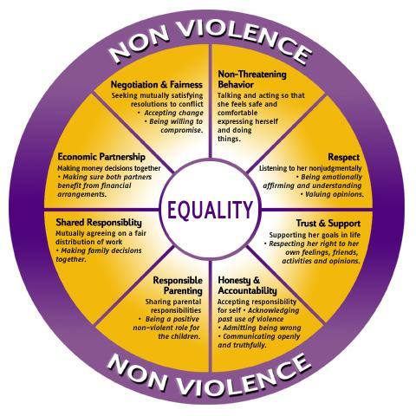

Slide 25
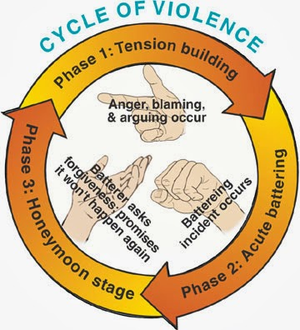

Slide 26
Models of Batterer’s Intervention Programs
The Duluth Model (Duluth Domestic Abuse Intervention Project)
Most widely used program model for batterers’ intervention.
Features victim safety and community coordination.
Confronts the denial of violent behavior, exposing the elements of power and control.
Offers alternatives to dominance and promotes behavioral changes.
Requires communitywide intervention using law enforcement, the courts, DV shelters, advocates, health providers and batterer’s programs.

Slide 27
.
It sees DV not as a form of pathology, anger and hostility, but as an outcropping of men’s socially sanctioned domination of women.
They educate men about power and control, not just to assist them in managing anger or personal problems.
Communitywide coordination ensures that batterers are arrested and protected and the victims are protected.

Slide 28
2. Psychoeducational model
Promotes responsibility for violent behavior and the development of mechanisms for self-regulations, empathy or compassion for others.
Teaches appropriate emotional vocabulary to express intimacy and changing attitudes toward women.
Model how to handle anger stress management and proper assertiveness skills.
Safety precautions for significant others, no-violence contracts are used.
Group and individual therapy can be used with this model.

Slide 29
3. 3 Cognitive Behavioral Therapy (CBT)
Clients analyze relationship between thoughts, feelings, and behavior
Clients are helped to recognize triggers, risks factors, negative self talk, and decisions that lead to abusive behavior
Use of role playing, skills practice, and group reinforcement, relaxation techniques
Identify and debrief past and future high risk situations

Slide 30
4. Couples therapy
Treats men who batter together with their partners, often in a group setting.
This model is criticized because of the concern for safety. It implies that both partners are equally responsible for the violence.
It fails to recognize the role of gender and historical power inequities.
It cannot be used by a DV Program in CA (in Penal Code)

Slide 31
Newer Developments in DV Offender Treatment
Trauma Focused
Attachment Focused
Feminist Model
Family Dynamics, historical patterns
Co-Occurring TX with Drug and Alcohol

Slide 32
Overview of a Batterer
Batterers appear to:
have intense, dependent relationships with their victims
have low self esteem
believe all the myths about domestic violence
be traditionalists, believe in male supremacy and stereotyped masculine sex roles
have poor impulse control or explosive tempers
have limited tolerance for frustration and severe reactions to stress
often present a dual personality- loving or violent

Slide 33
have difficulty acknowledging or describing feelings
deny an minimize their violent behavior
not believe their violent behavior should have negative consequences
be extremely jealous, passive, controlling and fear they will be abandoned
be depressed and vulnerable to drug and alcohol abuse

Slide 34
Why do batterers continue to abuse?
Many have been violent throughout their relationship with their victims.
They use violence as a way to mange everyday stress and frustrations.
Can’t use violence at work, because they would be fired.
They have unrealistic expectations of themselves and their partners and have low self esteem.
They are extremely dependent on their partners for their sense of self-worth and for a sense of control over their lives.

Slide 35
Because of this dependency they may be jealous and possessive of their partners.
Abusers may not like their violence, but they know of no other options.
They do not accept what they are doing, so they minimize, deny and even lie about their abuse.

